Slide 1
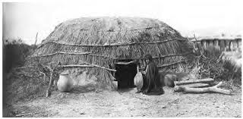
Diabetes prediction
Srikanta Patra
General Assembly – Data Science Immersive Capstone

Slide 2
Notable Quote
Humans are not good when 500 variables affect a disease. We are guided too much by opinions, not by statistical science.” –Vinod Khosla

Slide 3
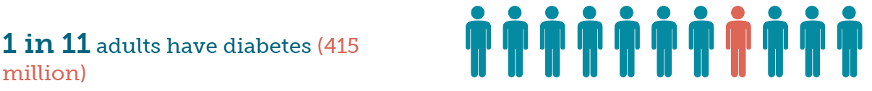
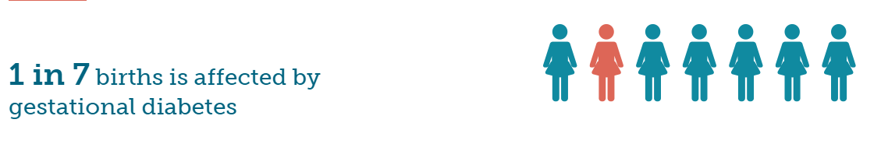
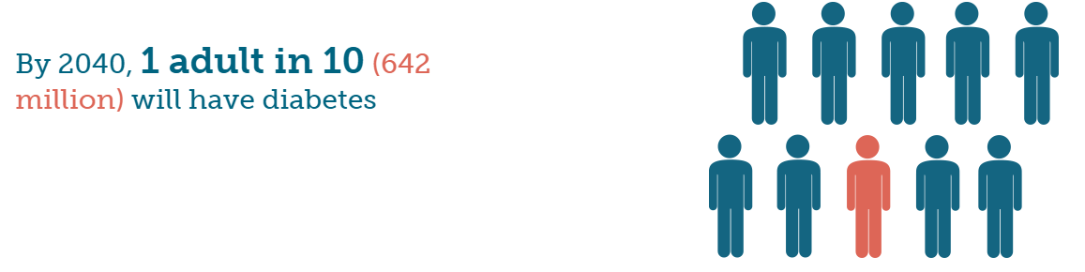
Ideation & Motivation

Slide 4
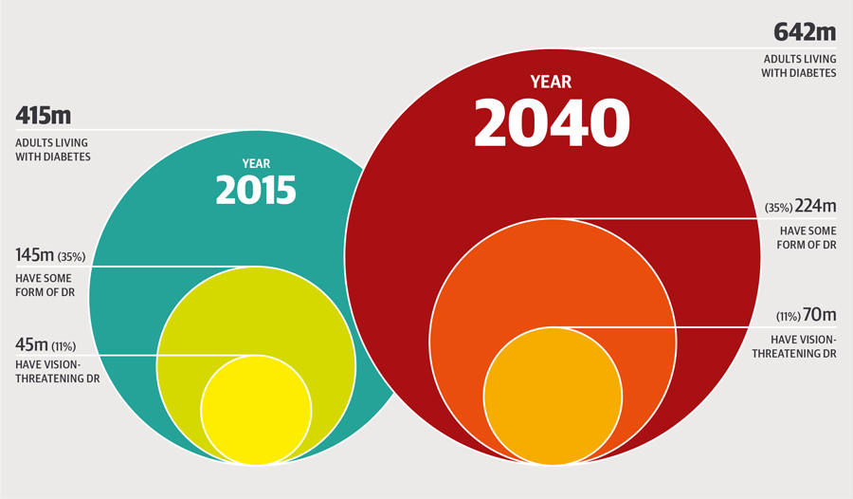
Ideation & Motivation

Slide 5
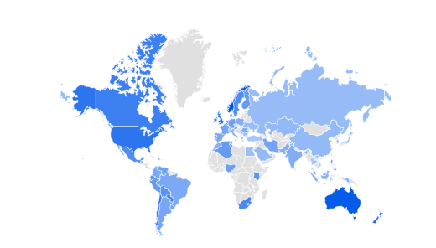
Look Who is Watching
Google Trend on Diabetes

Slide 6
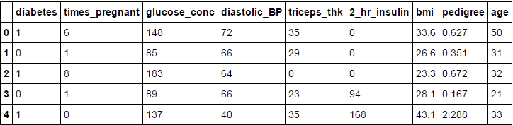
Data
Pima Indian Diabetic Dataset

Slide 7
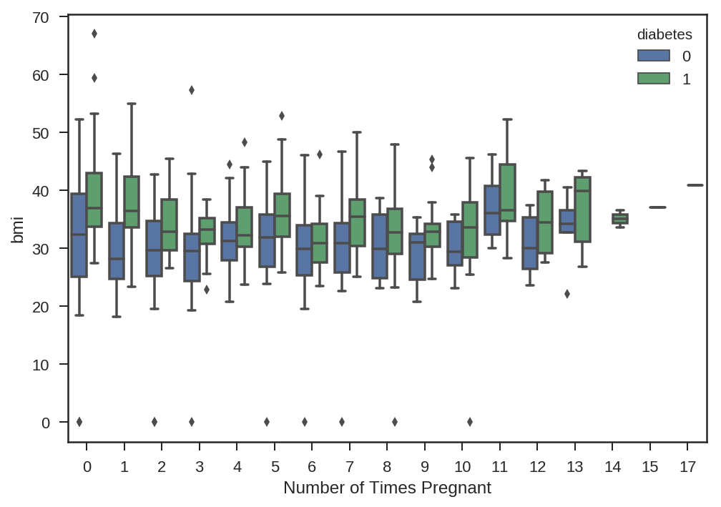
Data

Slide 8
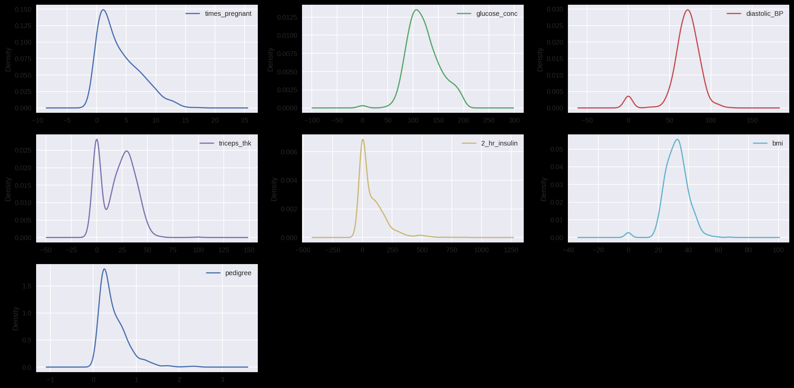
Data Distribution

Slide 9
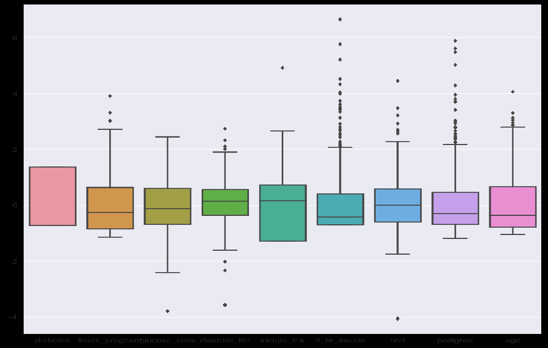
Nature of Feature

Slide 10
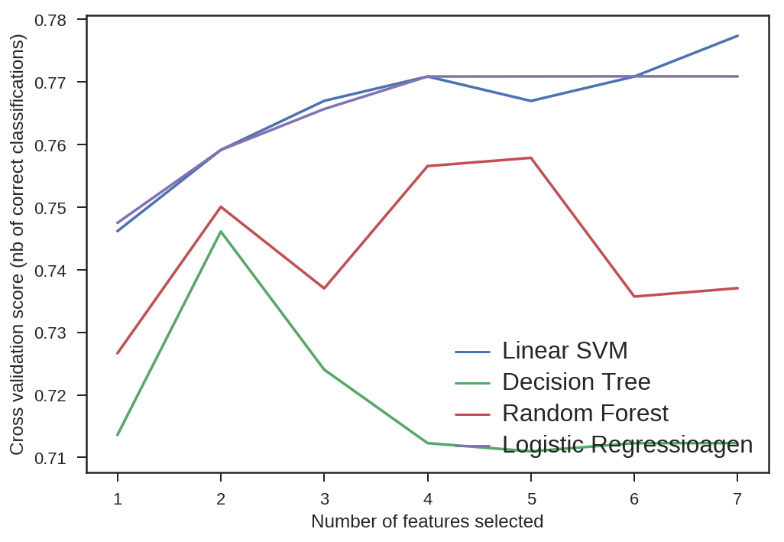
Feature Elimination

Slide 11
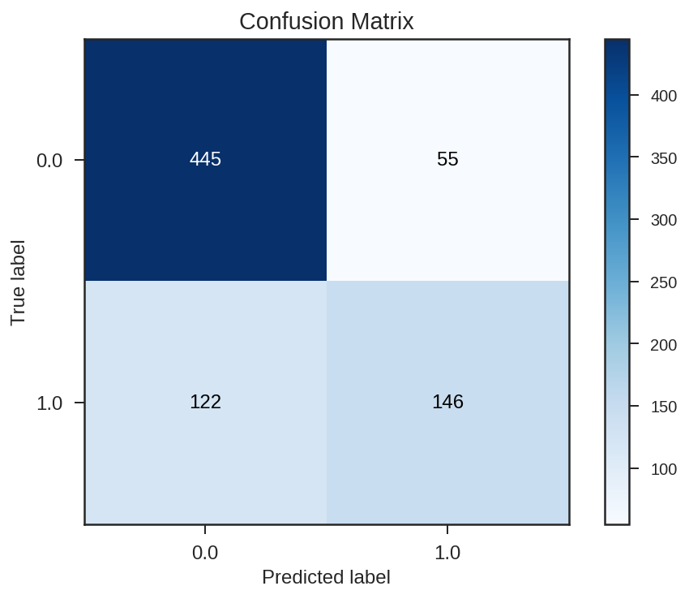
Model Performance
Naïve Bayes

Slide 12
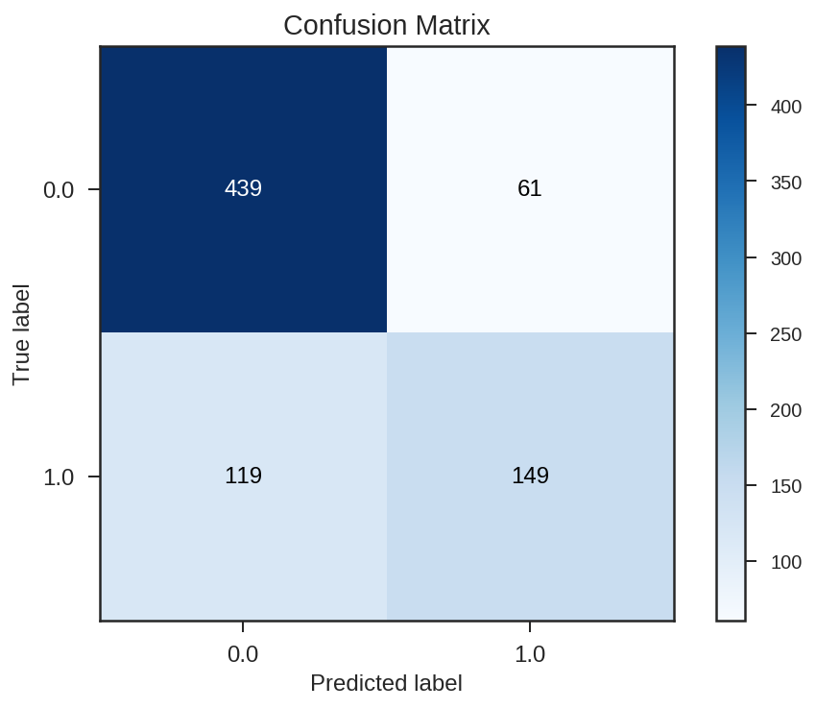
Model Performance
Logistic Regression

Slide 13
Enhancements
Neural Networks
Principal Component Analysis
Tuning of models to improve accuracy
Try Ensemble techniques

Slide 14
Conclusion
Diabetes is a preventable disease.
My goal is to use my knowledge of Data Science to improve the accuracy of diabetic prediction to the best possible extent and help the medical community take preventive actions.

Slide 15

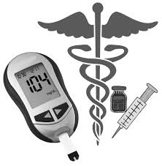
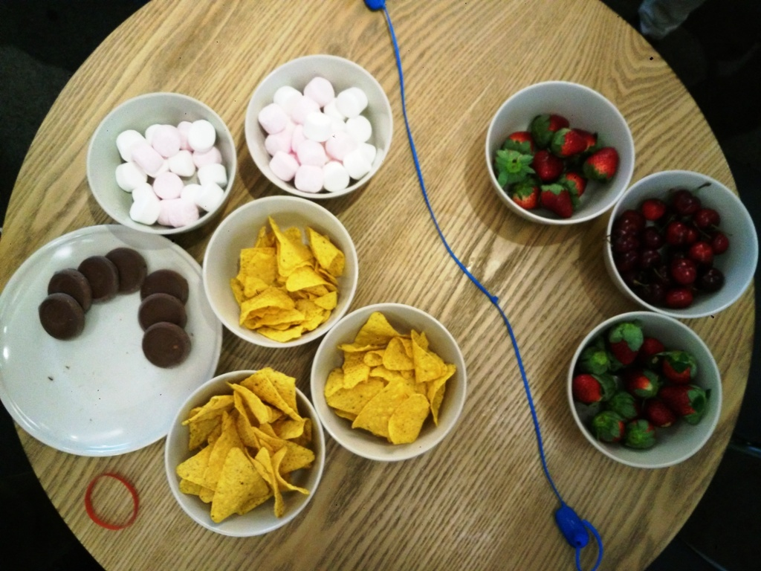
Classification at Class

Slide 16

Thank You
Acknowledgement:
My great General Assembly team
Elaina, Tui and Paul McLeod

